Slide 1
Moon Travel
Design a graph representation of a real-life problem, and implement various pathfinding algorithms on the graph.

Slide 2
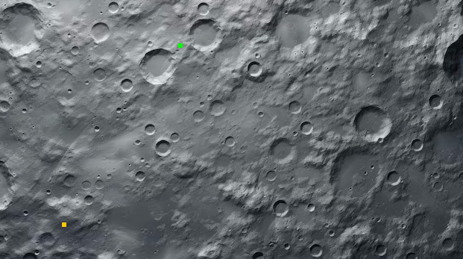
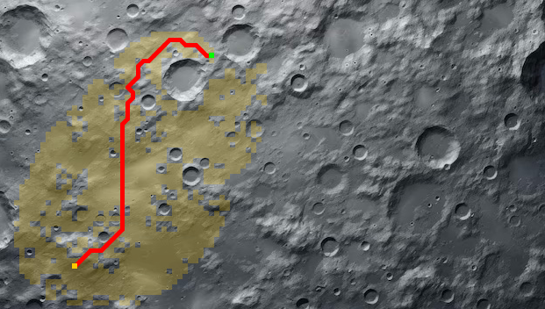
the Moon Travel problem definition
The surface of celestial bodies such as the Moon is characterized by a rugged terrain filled with mountains and craters, as depicted in the image below:
In pursuit of scientific exploration, humans deploy rovers in such a harsh environment, which travel from place to place carrying and utilizing delicate scientific equipment. As such, the routes they travel need to avoid the most rugged features of the terrain, while at the same time minimizing the energy usage by seeking the shortest path between the route endpoints.
The objective of this project is to determine the optimal path a rover needs to follow to travel between any two points on the map. The only data available to accomplish this task is a high-resolution image of the terrain.
The program will extract information from the image and create an object-model representation of the terrain. Once the image is loaded and processed, the user will be able to define a start and a target point anywhere on the map, and display in an interactive fashion the optimal path the rover can follow in between these points.
You are provided with a Java startup project MoonTravel_Startup.zip, which already contains a test map image. When complete however, the program should be able to run on any similar image you can download from the internet and determine optimal paths between any two points on that map.
The startup project is pre-wired to use a MoonMap class from the DrawingLib API which gives the ability to load, manipulate and interact with the map image pixels. Your task is to complete the code by creating an object model for the moon map, load the data and design and implement the necessary data structures and algorithms such that the rover can navigate safely and optimally on the moon.

Slide 3
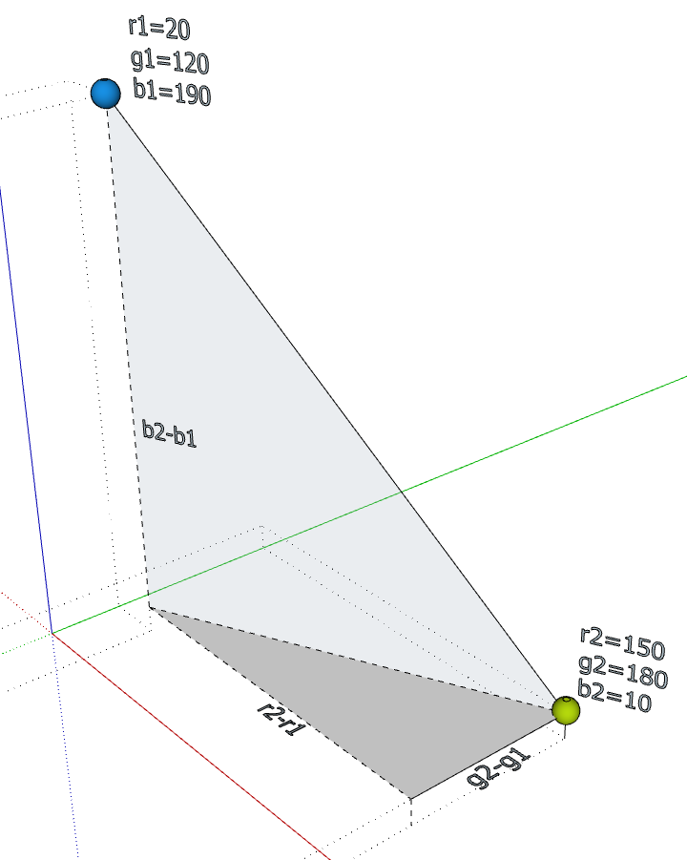
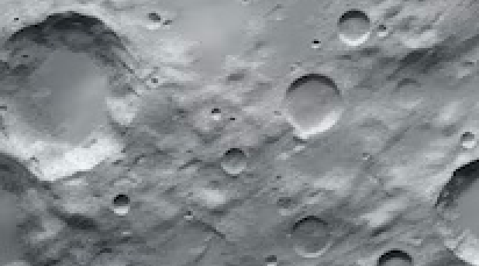
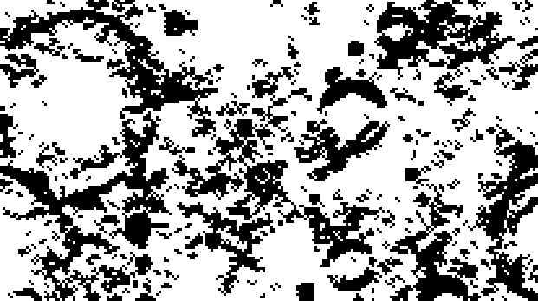
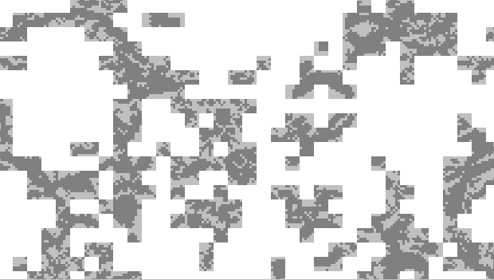
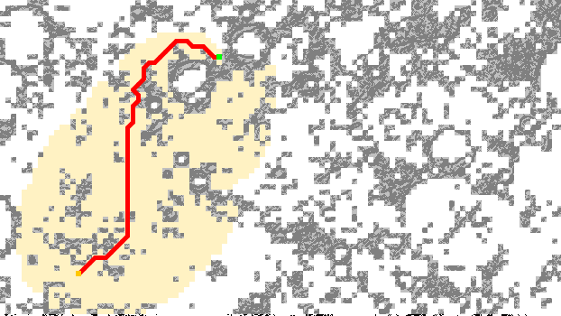
the Moon Travel problem breakdown
To figure out how to route a rover around the terrain features, we first need to identify where are these features located. Given that the image is the only information we have, we notice the light is reflected differently by the mountains, ridges, craters, etc. This relates to differences in the colors of the pixels: in a crater area pixels are darker or brighter than the ones in their vicinity, based on how the crater rim is illuminated. In either case however, the common trait is the significant difference in color, compared to the color of their neighboring pixels. We can rely on this color difference to build an understanding of the terrain, by solving the following sub-problems:
Quantify the color difference between two pixels: The color of a pixel is defined as a mixture of the three fundamental colors: red, green and blue, each of specific intensity encoded as a byte value (0-255). If we consider these values as spatial coordinates in a 3D space, then the color difference between $Pixel_{1}=\left(r_{1},g_{1},b_{1}\right)$ and $Pixel_{2}=\left(r_{2},b_{2},g_{2}\right)$ is nothing more than the eucledian distance between their corresponding 3D points:
$ColorDiff\left(Pixel_{1},Pixel_{2}\right)= \sqrt{{\left(r_{2}−r_{1}\right)}^{2}+{\left(g_{2}−g_{1}\right)}^{2}+{\left(b_{2}−b_{1}\right)}^{2}}$
Contrast the surface image: Imagine a simple transformation of the map image, such that pixels having the color difference with any of its immediate neighbors above a certain color_distance_threshold are colored black, all the other are colored white. Essentially this is a contrast filter resulting in a highlight of the prominent features of the terrain:
The threshold value can be determined empirically, by visually deciding how prominent a feature should be in order for considering it impassable. Good starting value can be anywhere in between 40.0 and 60.0.
Pixelate the contrasted image: Having a label for each pixel as “passable” (white) or “impassable” (black) might be a representation too granular for a route searching algorithm. An optimization is to grid the image in small rectangular areas of a certain pixelate_area_size. Each area is to be marked “passable” / “impassable” based on a certain pixelate_dark_pct value
which gives the granular percentage of black pixels within that area. We have now a representation of the entire terrain identifying the areas of passable and impassable terrain. All what’s left is to devise a pathfinding algorithm guiding our rover from a start_area to a target_area, both passable, by avoiding all impassable areas along the way.

Slide 4
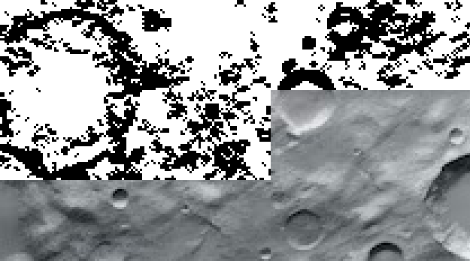

the Moon Map image processing
In this project the basic image processing tasks are available by means of the MoonMap class, itself part of the Drawing-Lib library package. The jar package itself is already embedded in MoonTravel-Startup.zip you are provided but can also be downloaded from here. With it, we can load a high-resolution map image in memory, extract and modify the color of custom areas of pixels or draw segments in custom color and at custom locations on the map. In addition, the MoonMap class allows us to take and restore snapshots of the image in any of its transformation stages. This allows us to code a richer user interaction by interactively visualizing the map in either raw, contrasted or pixelated form.
Image processing is generally a compute and memory intensive operation working on potentially huge data sets. The program should not crash because a larger input image exceed the available hardware resources. As such, it is important to design the code in such a way that patches of the image are being processed one at a time. This also allows for parallelizing such operations on distributed compute environments (multiple computers working cooperatively on the same task).
Contrast filter
Pixelate filter
This filter works on areas (patches) of pixels. It determines the maximum color difference between each pixel and each of it’s 8 neighbors. If that exceeds a configured threshold, the pixel is colored black, otherwise it is colored white.
The pseudo code for this filter is as follows:
define a CONTRAST_AREA_SIZE
define a COLOR_DISTANCE_THRESHOLD
foreach contrastArea in the moon map image do
foreach pixel in the contrastArea do
foreach neighboringPixel of pixel do
if colorDistance(pixel, neighboringPixel) > COLOR_DISTANCE_THRESHOLD then
set pixel to Color.BLACK
else
set pixel to Color.WHITE
end if
end foreach
end foreach
overlay contrastArea on the image
end foreach
take a contrast snapshot of the resulting image
This filter works on areas (patches) of pixels on the contrasted image. It calculates the percentage of black pixels within that area. If that exceeds a custom threshold the area is designated as impassable. All pixels in an impassable patch are darkened, all in
a passable patch are colored white. The filter returns a double array of Booleans, indicating whether that area is impassable (true) or passable (false).
define a PIXELATE_AREA_SIZE
define a PIXELATE_DARK_PCT
create a terrain[][] of Booleans each standing for one MapArea
foreach mapArea in the moon map image at a row and col position do
calculate percentage of black pixels in the area
if percentage > MAPAREA_DARK_PCT then
terrain[row][col] = true
set mapArea pixels to dark colors
else
terrain[row][col] = false
set mapArea pixels to Color.WHITE
end if
overlay mapArea on the image
end foreach
take a pixelate snapshot of the resulting image
return terrain
Which methods implement the contrast filter?
What is the contrast areas size configured into the code?
What is the default color distance threshold?
For a map of 626 x 352 pixels and the default contrast areas, how many rows and columns of contrast areas are going to be processed by the contrast filter?
Which methods implement the pixelate filter?
What is the pixelate area size configured into the code?
What is the default percentage of dark pixels causing an area to be designated as “impassable”?
What parameters would you change to increase the density of the dark pixelate areas?

Slide 5
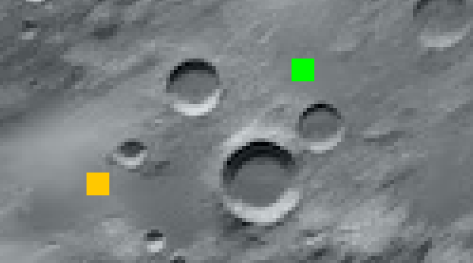
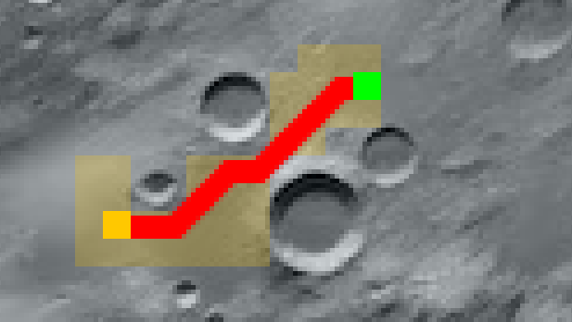
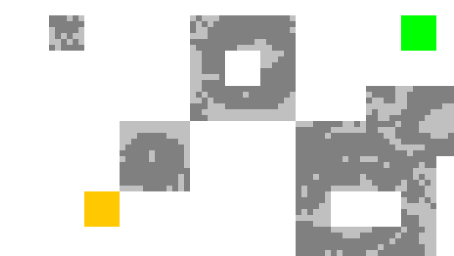
the Moon Map graph representation
At this moment, we have an understanding of the map areas which can be traveled through by our rover, as well as the ones which are inaccessible due to the roughness of the terrain. These areas are small rectangular patches of pixels, designated by the pixelate filter as passable or impassable. Each area is identified by the (x,y) coordinates of its top-left corner, and the size, in pixels, of its side.
The rover starts from a chosen point, contained in the startArea, with the objective of reaching another point, contained in the targetArea. Determining the route means determining the sequence of neighboring areas chaining the path from startArea to targetArea. Determining the fine-graned route within the extends of an area is beyond the scope of this project.
targetArea
calculated route from startArea to targetArea
There is sufficient clarity now to start defining an object model for this problem.
The MapArea class is modeling the individual areas, with all their needed attributes: the (x,y) coordinates of the top-left corner, the row and colum of its placement in the image, the background double array of Colors for the individual pixels within the area and the specific overlayColor for its own visualization. Other fields can be added as needed.
The MapModel class is modeling the entire terrain as a container for all the MapArea objects within the image. A MapModel object can be seen as a graph containing a double array of MapArea objects, standing for the nodes in the graph. Each node, is linked by the nature of its row and column positioning to the neighboring areas open for travel (passable). Specific MapArea objects are initialized in the graph, standing for the startArea and targetArea. Another unique MapArea object can be created as a place holder for all the impassable areas.
In this object representation we have now the foundation for implementing route finding algorithms and to determine the path from startArea to targetArea.
startArea
When the user clicks on the map, the startArea and targetArea are defined as new MapArea objects. Where in the code (class and method / line#) are these objects created?
For a map of 626 x 352 pixels, what will be the value of the _size field in the startArea and targetArea MapArea objects?
What are the startArea and targetArea overlay colors and where in the code are they defined?
`
Where in the code (class and method / line#) does the MapModel object modeling the terrain get created?
For a map of 626 x 352 pixels, how many rows and how many columns will the _terrain field have within that MapModel object?
What is the value of _terrain[r][c] assuming the map area at that row and column is impassable?
What is the initial value of the _terrain[r][c] assuming the map at that row and column is passable?

Slide 6

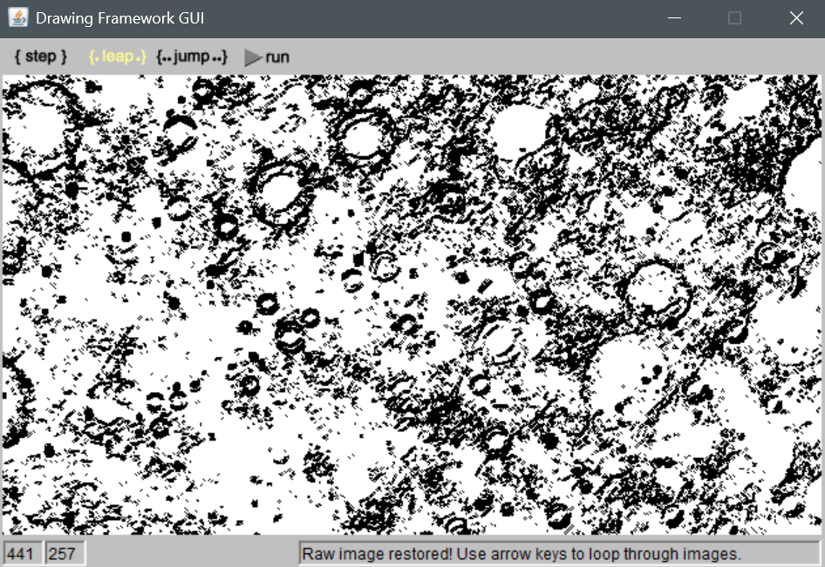
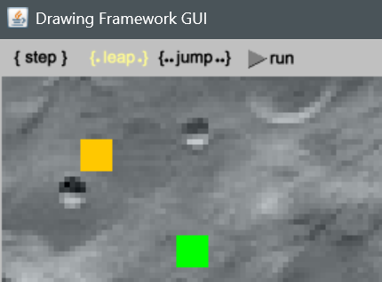
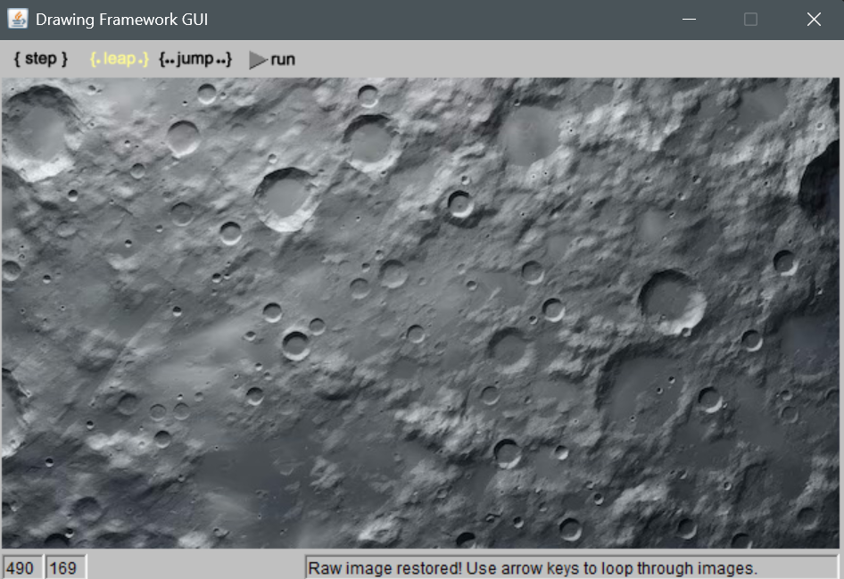
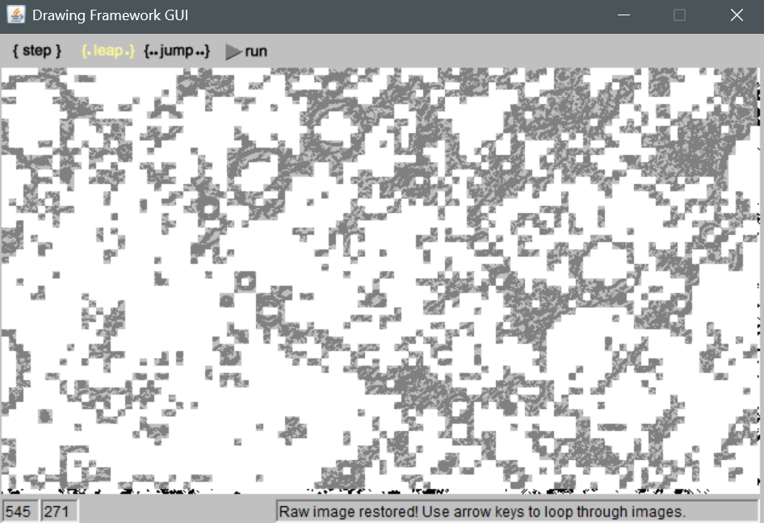
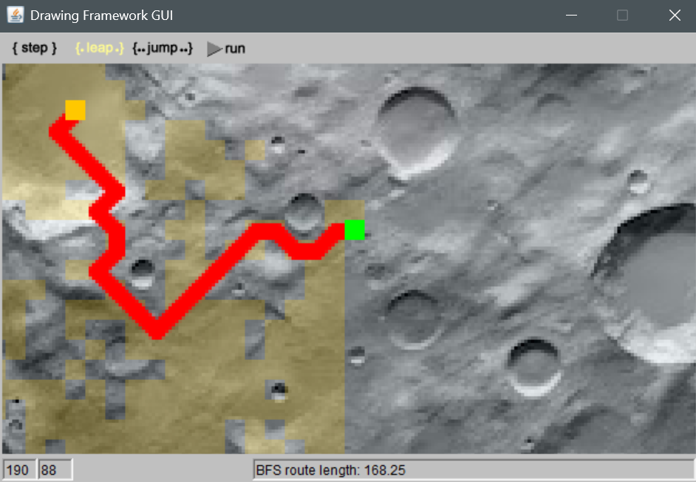
the Moon Map user interface
The startup project includes code allowing for a simple yet visually relevant user interaction. As the program starts, it loads the map image and applies sequentially the contrast and pixelate filters. After each operation the execution pauses in a waiting for the user action to continue. After the map is loaded and displayed there are three kinds of UI actions available at any time and working independently from each other.
Change background image
Key-press on RIGHT / DOWN / UP / LEFT to cycle through backgrounds
Set / Reset startArea and targetArea
Mouse-click on the image to set, or clear one or both of startArea and/or targetArea. if clicked an impassable area then no action else if clicked either of startArea or targetArea then reset that specific area ← null else if startArea == null then set startArea ← area that was clicked else if targetArea == null then set targetArea ← area that was clicked else reset startArea ← null reset targetArea ← null end if
CONTRAST
RIGHT / DOWN
RIGHT / DOWN
LEFT / UP
LEFT / UP
startArea
targetArea
RIGHT / DOWN
LEFT / UP
Trigger route calculation
Key-press on <B>, <D>, <A> to trigger route calculation via specific algorithms. Key-press <B> → route from startArea to targetArea via the Breath-First-Search algorithm Key-press <D> → route from startArea to targetArea via the Dijkstra algorithm. Key-press <A> → route from startArea to targetArea via the A* algorithm.
RAW
PIXELATE
Where is the code that gets executed (class, method / line#) for changing the background image?
Where is the code hook (class, lambda method) that gets executed for setting / resetting the startArea and/or targetArea? Which method is called to actually perform the action?
Where is the code hook (class, lambda method) that gets executed for triggering the route calculation?
TO BE IMPLEMENTED
TO BE IMPLEMENTED

Slide 7
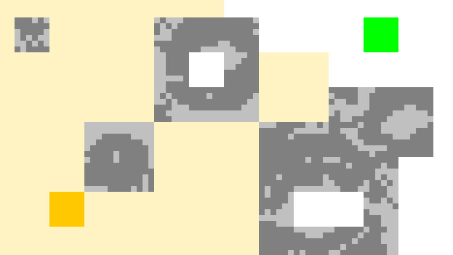
the Moon Travel pathfinding algorithms
Finding an optimal route between two points on a map is a fundamental problem in digital mapping. However, this problem is just a specialization of a more generic problem in graph theory: finding an optimal path between two nodes in a graph. There are many algorithms solving this problem, the most established ones are:
Breadth-First-Search: from a start node, step sequentially from each node to its neighbors that were not visited already. At each step, leave a „bread crumb” pointing backwards {node ← neighbor}. Stop when the target node is reached and reconstruct the route following the „bread crumbs”.
Dijkstra: from a start node, step sequentially from each node to its neighbors if the distance {start → node} was shorter than anything tried before. At each step leave a „bread crumb” pointing backwards {node ← neighbor}. Stop when all nodes were explored and reconstruct the route following backwards „bread crumbs” from the target node back to the start node.
A*: from a start node step from each node to its neighbors if the end-to-end route {start → node → neighbor → target} was shorter than anything tried before. At each step leave a „bread crumb” pointing backwards {node ← neighbor}. Stop when the target node is reached and reconstruct the route following backwards „bread crumbs” from the target node to the start node.
These algorithms have very similar code structure, depicted by the pseudo-code below:
Note the following methods in the pseudo code:
should_step_to()
update_state()
check_termination_condition()
Their implementation is dependent on the specific pathfinding algorithm being implementing.
routeAlgo(startArea, targetArea):
queue ← new Queue<MapArea>
queue.add(startArea)
while queue not empty do
crtArea ← queue.remove()
foreach neighbor of crtArea do
if should_step_to(neighbor) then
update_state(neighbor)
queue.add(neighbor)
if check_termination_condition() then
break
end if
end if
end foreach
end while
if targetArea has “bread crumb” then
reconstruct route from targetArea to startArea
return route
else
return “route does not exist”
end if
end routeAlgo
The startup project provided to you already includes the implementation for the Breadth-First-Search algorithm:
Which method from what class implements the algorithm? What is that method returning?
Which line of code (from what class and what method) is responsible for avoiding the impassable areas on the map?
Which method from what class is tracing back the “bread crumbs” from targetArea back to startArea in order to reconstruct the route once the algorithm is complete? Hint: method should contain a loop that starts from _targetArea.
When route is displayed, the total distance traveled is displayed in the status bar: Trace the code that ends with displaying that value.

Slide 8
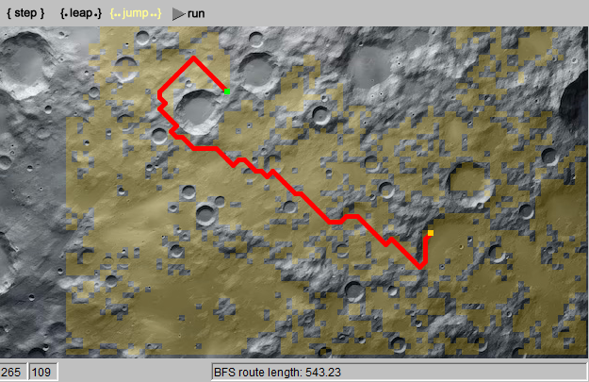
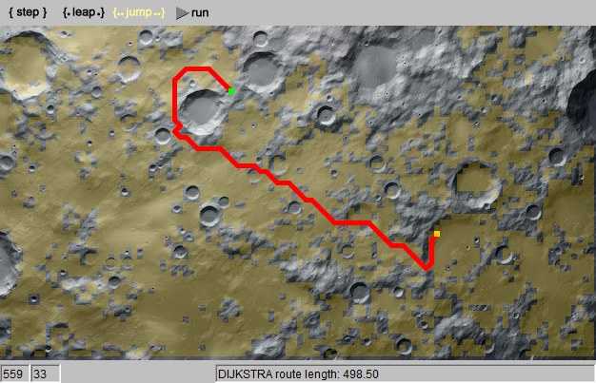
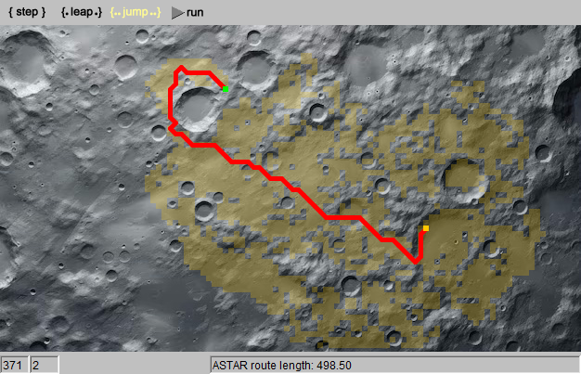
the Moon Travel pathfinding via Dijkstra and A*
You now possess a comprehensive understanding of the MoonTravel code base, which features the implementation of the Breadth-First Search pathfinding algorithm as an example. Utilize this knowledge, along with your understanding of graph theory, to finalize the project by implementing both the Dijkstra and A* algorithms. Notes:
To implement the A* algorithm, you will require a PriorityQueue. You can adapt your previous project’s implementation of priority queues by copying and modifying the PriorityQueue.java and HeapPriorityQueue.java files as necessary.
You might need to add or modify fields and methods in any of the classes within this project. As the code base owner, you have the freedom to make any necessary changes.
Once the project is finished, test various routes and analyze the performance and outcomes of the three algorithms: Breadth-First Search, Dijkstra, and A*. Take notes and discuss the following points:
Which algorithm yields the shortest distance when comparing routes with identical start and target locations?
Which algorithm provides the fastest route identification? What visual aspect of the map reflects the algorithm performance?
Are the routes identified by the Dijkstra and A* algorithms always identical?

